Slide 1


Wind Turbines and Machine Learning
Huma Chaudhry

Slide 2

Overview
Data Scraping
Scrape Data
News
Images
Tables
Main Website
Flask API
MongoDB
DataBase
APIs

Slide 3
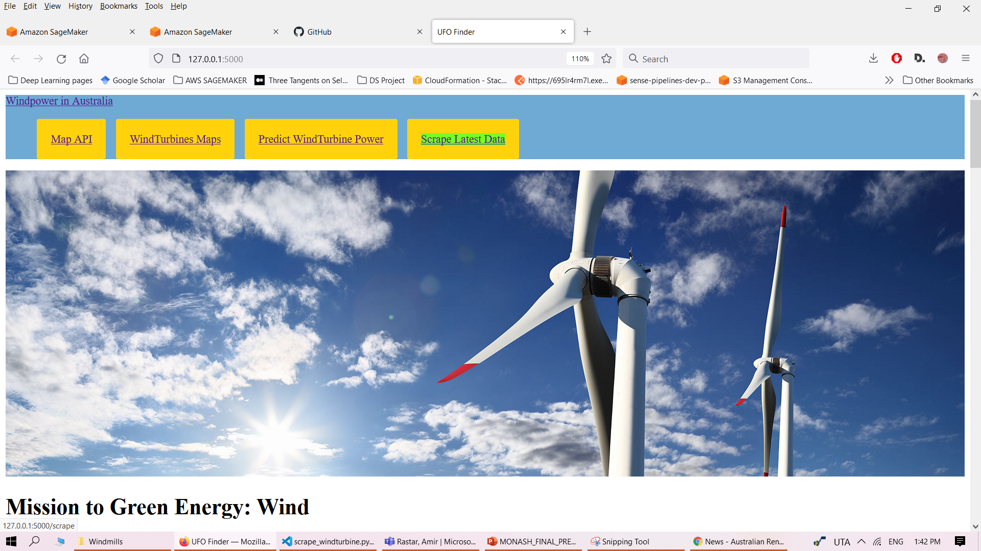
Home Page Tabs
MAP DATA API – Latitude/Longitude
Map – Location of WindTurbines
Predict Power generated from a WindTurbine based on user input
Scrape Latest data, news, Images from web

Slide 4

Latest Windturbine News

Slide 5
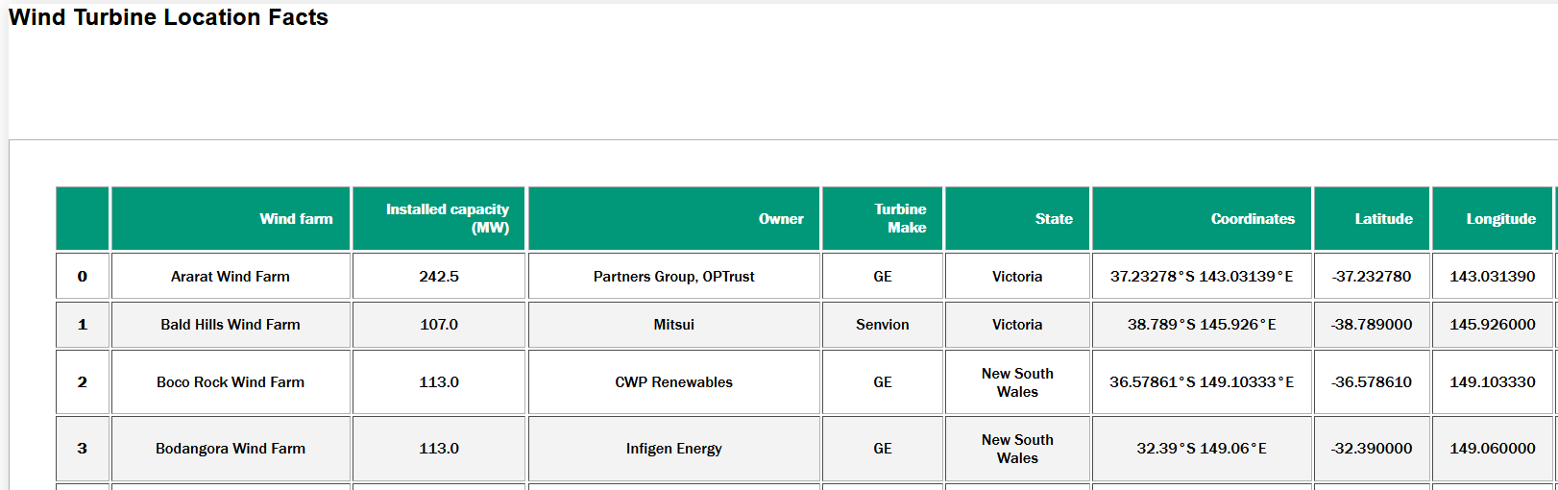
WindTurbine Data (Australia)

Slide 6
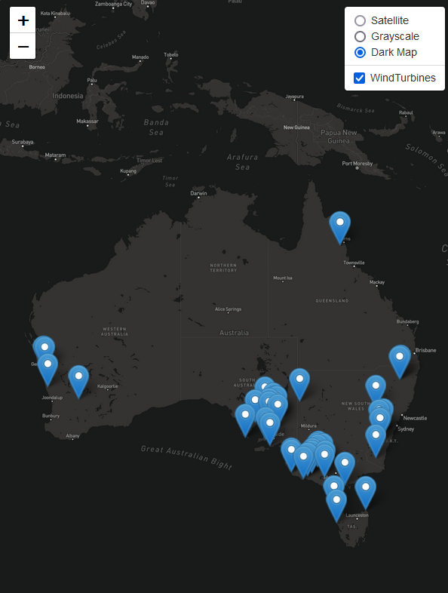
Wind turbine locations across Australia

Slide 7

Predict Windturbine Power

Slide 8
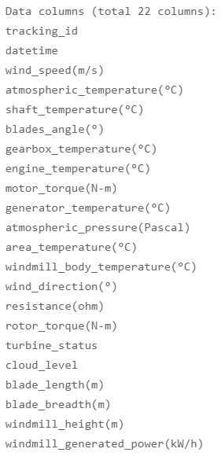
WindTurbine Features for predicting how much power is generated vai WindTurbines

Slide 9
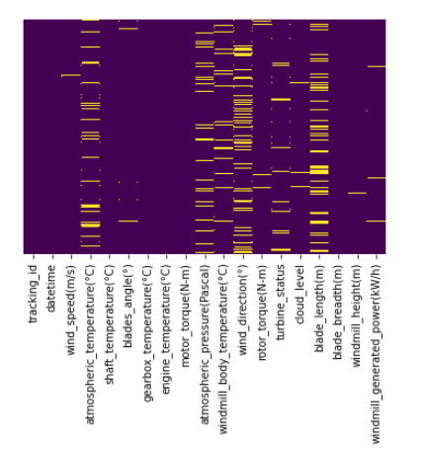
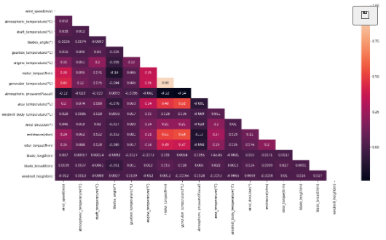
Some Preprocessing examples used in this project
Remove correlated Features,
Mean replace NaN,
Convert Categorical features, e.g. Cloud_Level, into ordinal encoding

Slide 10
Most Important Features Selection
Feature ranking with recursive feature elimination.
Notes:
Given an external estimator that assigns weights to features (e.g., the coefficients of a linear model), the goal of recursive feature elimination (RFE) is to select features by recursively considering smaller and smaller sets of features. First, the estimator is trained on the initial set of features and the importance of each feature is obtained either through any specific attribute or callable. Then, the least important features are pruned from current set of features. That procedure is recursively repeated on the pruned set until the desired number of features to select is eventually reached.

Slide 11
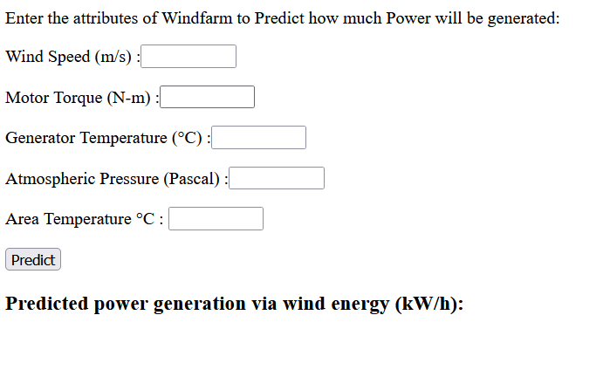
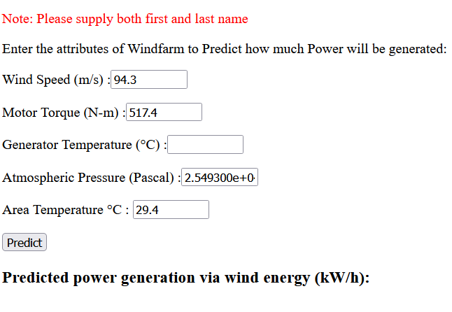
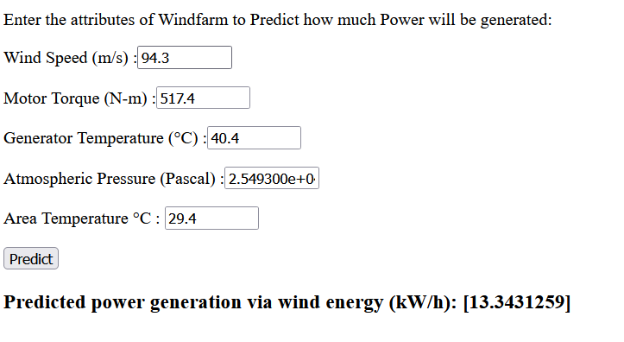
Predicting Power
Trained model is used to predict Power

Slide 12
Conclusion
Motivation
Learning
Limitations

